Slide 1
Smart contracts for resource planning and management
Miulescu Cristina-Maria
SCPD

Slide 2
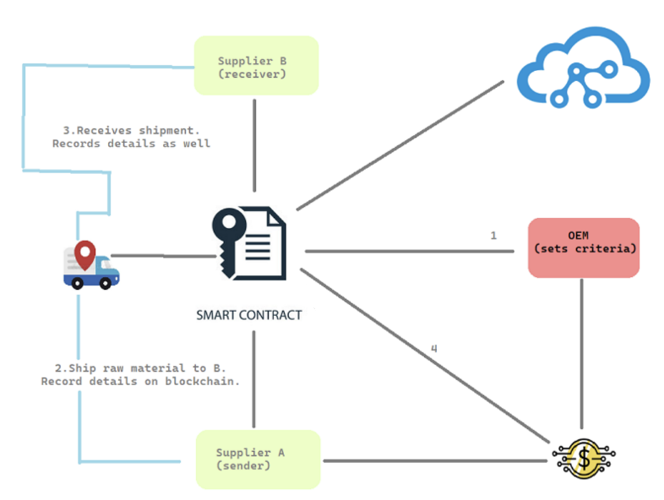
Main idea
Improve the Supply Chain Management through the use of smart contracts by addressing two main aspects:
Traceability – allowing inventory tracking
Efficiency - through simplified automated processes initiated by smart contracts

Slide 3
Smart contracts implementation
ItemManager.sol
Item.sol

Slide 4
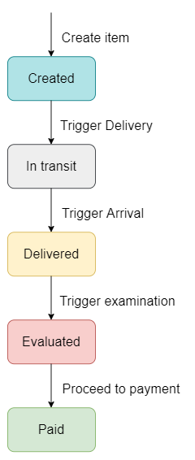
Item manager

Slide 5
Item
Provides address for each item in the ItemManager
Address is used for payments

Slide 6
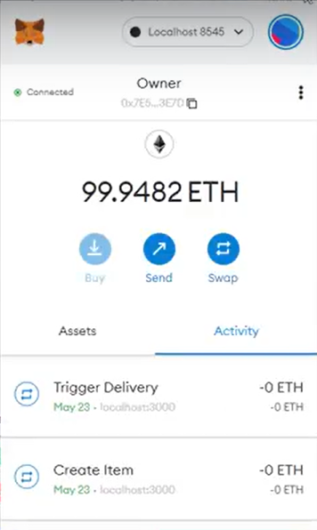
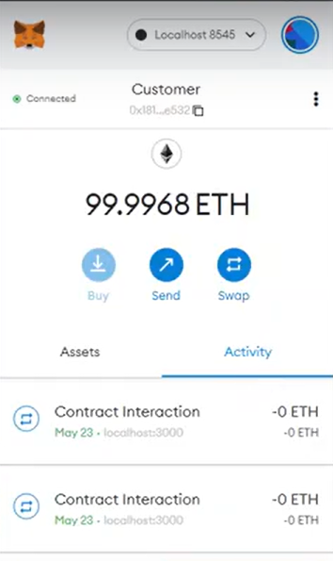

metamask

Slide 7
Owner
Customer
Owner of the smart contract
Creates new items
Delivers the items
Receives the items
Evaluates the items
Pays for the items

Slide 8
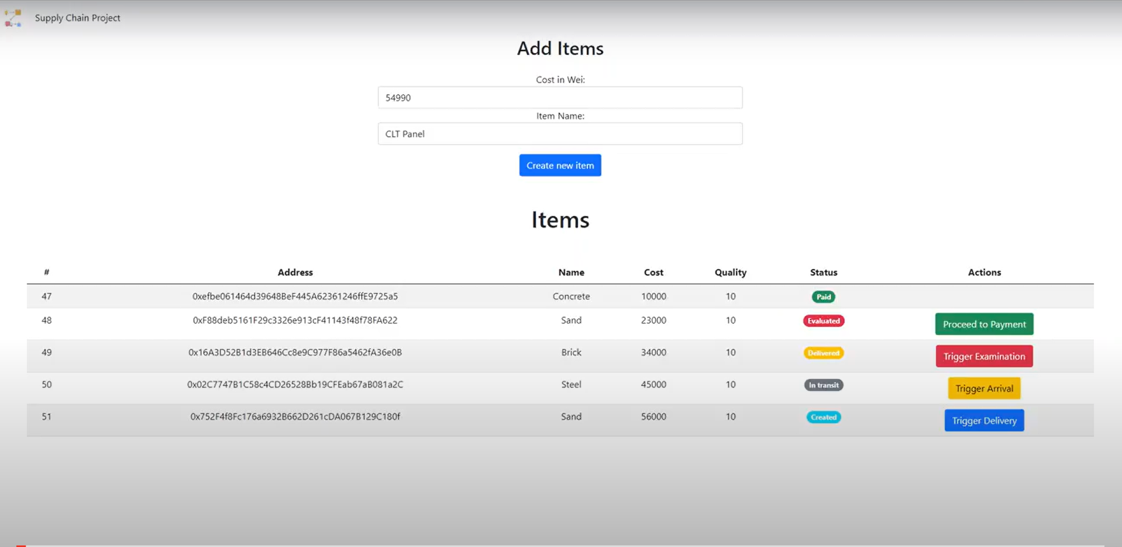
Supply chain monitoring

Slide 9
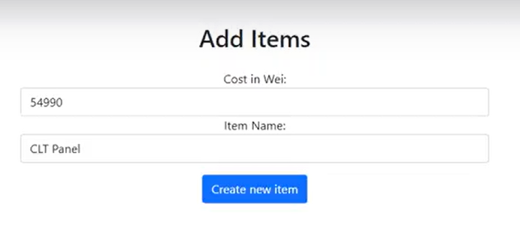
Create items

Slide 10
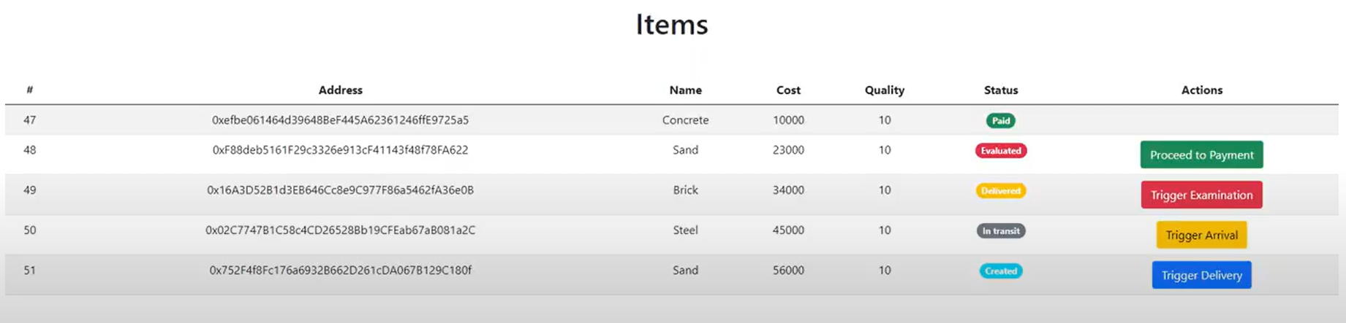
Items view
Unique ID
Address to pay
Name
Cost
Quality
Status
Actions

Slide 11
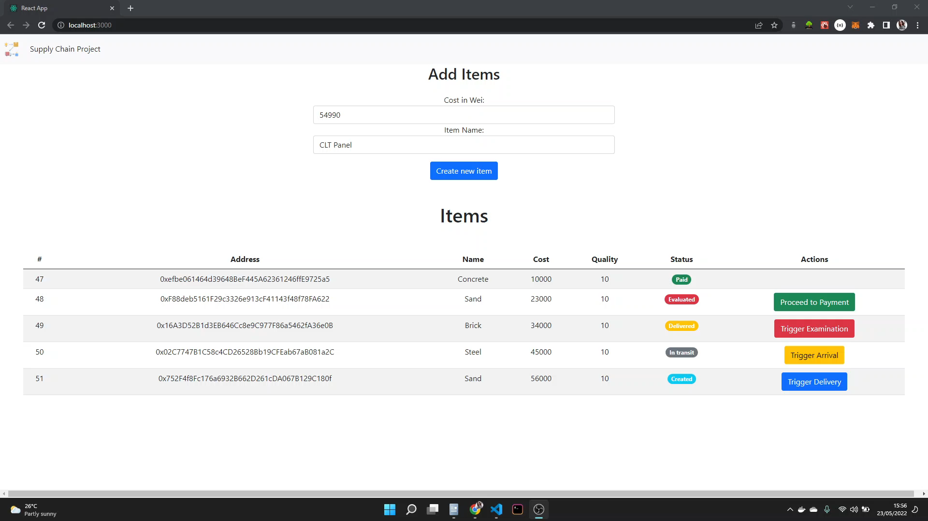
demo

Slide 12
Further improvements
Add to more information when creating an item
1
Add evaluation to frontend to determine quality
2
Add authentication for customer and owner (using Metamask)
3
Add a database
4

Slide 13
Thank you

